Slide 1
OPEN COURSE OF DEPT. OF MATHEMATICS
SUBJECT CODE : MAT5D02
SUBJECT NAME: MATHEMATICS FOR NATURAL SCIENCES

Slide 2

PAPER FOCUSES ON
Statistical tools for Data Analysis and Data Interpretation
MODULE 1:
Sets
Variables and Graphs
Frequency Distributions
Measures of Central tendency
The Mean Deviation

Slide 3
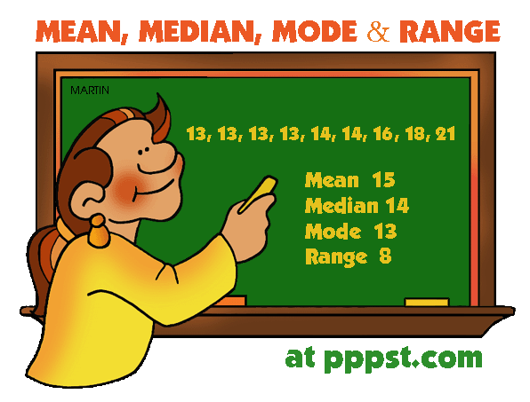
MODULE 2:
The Standard Deviation and properties
Variance
Moments
Skewness and Kurtosis

Slide 4

RELEVANCE OF THE PAPER
BPO companies use these statistical
tools for Data analysis.
Learning this paper is advantageous to
the students who seek jobs in BPO companies.

